Slide 1
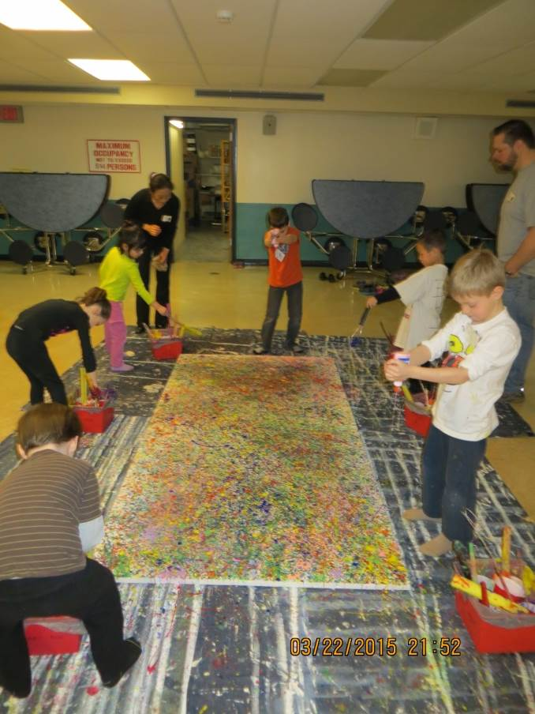
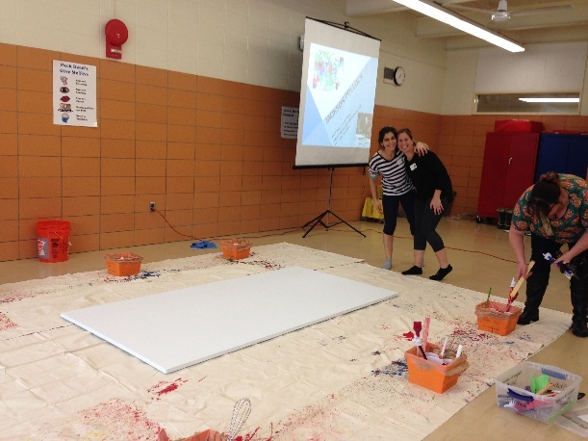
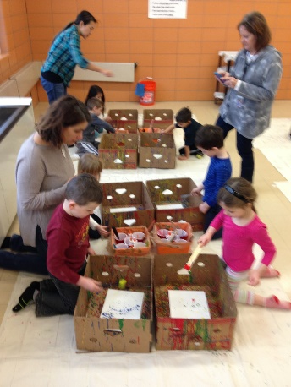
Kindergarten Art Ambassador
Pittsford PTSA
Jackson Pollock
“Paint Like Pollock”
By Teri Allart
Supply List
Project Time Line
Training
Prep
Project Outline
Volunteer Duties
(3) Stations:
Station #1: Large Class Pollock
Station #2: Art Canvas
Station #3: White Office Folders

Slide 2
PLEASE READ
District Art Ambassador (AA), Pittsford PTSA
PLEASE READ
These PowerPoint presentations for “Prep” and “Introduction” were written and designed by Teri Allart. A parent from Mendon Center Elementary who became Chair at MCE and was asked to become District Art Ambassador to bring her projects to the other Elementary schools of Pittsford.
As you read through, please check with your PTSA Chairperson to see how your school does things especially as it relates to Recruiting & Training.
Recruiting for Parent Volunteers (possible options): You will need to figure this out…
Sign up sheets. Typically done at the beginning of the year, listing email addresses. PTSA Chairperson for your school hopefully has.
“Volunteer Coordinator” for your school. Might handle all the recruiting for you.
Might designate someone on your team to handle all matters with seeking Volunteers.
Weekly PTSA e-mailer: can put a shout out to parents about seeking Volunteers.
School Web Editor and/or Webmaster might be able to add in the school’s e-mailer that AA is looking for Parent Volunteers. Hopefully, might be able to add a live link to allow parents to easily click to become a Volunteer.
Emailing Room Parent and requesting volunteers for the project.
Training:
There are (2) PowerPoints for each grade’s project: “Prep” for AA Chair/Lead AA and an “Introduction” which is what the students watch during the project. Most likely these are on School’s PTSA/Art Ambassador page, Google Drive or hard drive of the AA Chair. You will need to get these both.
The best way is to train Parent Volunteers week before the actual projects.
The “Prep” PowerPoint is printed out and inside the Master Art Ambassador book.
Videos created by Amy Klinsky and Teri Allart are available to see how each project is ACTUALLY DONE.
Go to: Pittsford PTSA website/Name of School/Art Ambassador/click the grade (located at bottom of the page along with (2) PowerPoints.
Send last few pages of the “Prep” PowerPoint to all Parent Volunteers, that are labeled “Volunteer Duties”
Tech:
Each school has different tech, so be sure to figure out how you are going to show the “Introduction” PowerPoint to the class.
Smartboard with Elmo OR Portable Projection both need a PC. If in the regular classroom usually we use the teacher’s PC. Anything outside of that will need your laptop or you might be able to borrow one from school.
Download the (2) PP’s or get access to your Art Ambassador’s Google Drive. Need to have the “Prep” + “Introduction” PowerPoint to show the students.
ALWAYS check Tech way before the project. Might need a special cable, tech changes all the time. Always check your tech!
You might need an ELECTRICAL CORD so you can move Tech around the room. Can ask Custodial Manager for one.
Room Layouts: Any and all layouts shown are suggestions only.
Room Usage Form:
When doing projects outside of the Teacher’s classroom, check to be sure of the room’s availability with the Main Office first. If ok’d, complete “Room Usage Form” (i.e., Cafeteria, Staff Cafeteria, Training Rm, etc.) and list all dates & times of use. You will also put any needed items; tables, portable tech, electrical cord, etc. for the Custodial department.
The guidelines of this project are written for use by the Chair Art Ambassador and/or Lead AA. Always check to see what your school has done in the past and follow, especially as it relates to the above items. As times changes and with new PTSA people, details of the above will most likely change too.
Presently, the District Art Ambassador is Teri Allart and the email to request PowerPoints is ptsa.artambassador@gmail.com. Other Pittsford Elementary AA: mceartambassador@gmail.com , prartambassador@gmail.com , aceartambassador@gmail.com , treartambassador@gmail.com
2/2016

Slide 3
Kindergarten AA: Jackson Pollock
MOST IMPORTANT
Scheduling:
VIP! Need 3-days. ALWAYS put (1) day in between projects so art and canvases have time to dry. NEVER schedule back to back. Schedule ONE class in the AM (9:30am), ONE in the PM (1:45pm) and then skip a day…. then follow the same schedule. Be sure to tell your LEAD TEACHER this is the schedule to consider when they are picking dates.
Contact LEAD TEACHER around NOVEMBER to request a few dates for January or March, via email. Check Cafeteria availability first with Main Office, before you confirm dates with teachers then complete Room Reservation Form.
Currently we have half day Kindergarten so the schedule should follow this example:
Monday (class #1 from 9:30-10:30am + class #2 from 1:45-2:45pm) & Wednesday (class #3 from 9:30-10:30am + Class #4 from 1:45-2:45). Do not schedule classes back to back… tarps, banana boxes, and projects will not be dry and will make a mess.
Logistics:
BE FAMILIAR with PREP PowerPoint and INTRODUCTION PowerPoint (students see in classroom) AND watch VIDEO to see prep and demonstration of the actual project. Find all by going to: Pittsford PTSA website / SCHOOL (select your school) / click on Art Ambassador / (select the grade).
(4-6) Volunteers PER CLASS (6-volunteers; 2 at each station works best). The more the better!
Project is done typically in CAFETERIA, all tables need to be removed, + 30-minute set up.
Figure out your TECH; projector, screen, cables, electrical cord, your laptop????
Have to show the “Pollock” Introduction PowerPoint (needs to be downloaded)
Project RE-USES (3-4) Class Pollock’s hanging in Auditorium/Cafeteria. It’s lots of layering just like Jackson Pollock did.
Need (2) SETS of LABELS from each Kindergarten teacher to have student name and their name plus AM or PM.
DRYING OF PROJECTS: Takes about 2-days. The LARGE 4’x8’ Class Pollocks need a lot of room and have to be dried FLAT. Office folders & Artists Canvas can be laid FLAT in the PTSA storage room.
Also let Kitchen Manager know the dates of the project.
Contact CUSTODIAN Manager to request the following: I’d recommend following it up with an email.
Let them know the dates & times of the project (plus add’l 30-minute set-up + 15-min clean up) so we can coordinate.
Complete “Room Reservation Form” to reserve the cafeteria (give to Main Office)
Need (1) large garbage that is lined with a bag (all left over paint in cups is thrown away)
Need to have ALL tables in area of project removed, putting in 3-stations plus a spot for the students to sit and see Introduction.
Need access to Janitorial Closet with WATER so tools can be cleaned and floors wiped up
Request an electrical cord so you can move the projector around.
FIND an AREA to dry all the LARGE 4x8 Pollocks
For PM class, need to help custodians get into room sooner by cleaning up or what ever is needed.
Request they get down the (3-4) LARGE POLLOCKS in Auditorium at least 2-weeks BEFORE the scheduled projects
Eventually give them NEW Velcro and ask them to re-hang all the LARGE 4x8 CLASS Pollock’s HORIZONTALLY once dried (2-days)
Supplies & Prep:
Purchase SUPPLIES NOW! Company can run out of paint. Prep paint and glue about 1-month before project. Look in AA storage bins for prep tools; funnel, empty bottles, empty gallons jugs, etc. AND look over the painting tools.
WILL BE DOING several “Drip Tests” with bamboo skewers when prepping paint. Each will need a different amount of AJAX to get it “drippy” enough.
This AA project is the biggest one. Kindergarten doesn’t get an Art class so this is their pay back. It takes 30-minutes to set up and about 15-20 minutes for clean up. It takes a lot of coordination, a lot of volunteers, prep and it’s the BEST ONE! Enjoy.

Slide 4
PARK Elementary email: To Custodial Manager
(Adjust to your school)
Kindergarten Art Ambassador (AA): Jackson Pollock
Attn: Park Elementary Custodial Manager
WINDOWS
(4) 6’x9’ tarps (doubled up)
INFORMATION FOR CUSTODIAL STAFF:
Cafeteria B, being used for 2-days for Pollock Art Ambassador project by Kindergarten. Students will see a short Introduction of Jackson Pollock and then do (3) projects that involve flicking washable Tempera Paint. There will be one day in between projects so that projects and tarps covered in paint can dry.
Student’s projects will be drying in the PTSA storage room & adjoining school storage behind stage plus the LARGE CLASS Pollock’s, we’d like to dry in the Storage Room with the KILN again.
Park AA Chair will confirm dates and time of actual projects prior.
Volunteers will arrive approximately 30-40 minutes before actual project is scheduled to go over project, set-up tarps, paint, supplies & tools, plus hook up tech. There is a 15-minute clean up.
NEED FROM CUSTODIAL STAFF: (Please place all items in Cafeteria B)
About 1-week before project, please take the (3) Pollock’s down from the Auditorium wall and store in a temporary safe place prior to project. FYI: once project is done, we’ll give you new VELCRO to rehang.
Need access to custodial closet with WATER unlocked.
Need ALL tables in cafeteria B, closed up and off to the sides and/or down hallway of cafeteria; we need to make room for 3-stations and students will be sitting on floor for an Introduction to project.
Need (4) AV carts; something with shelves so supplies, paint & art boxes can be moved back and forth.
Need ONE LARGE trash can that’s lined with plastic; for each scheduled project; there will be (3) total. All paint is thrown away after each project.
Need mop, and mop bucket with water
Need the portable Epson Projector on Podium, from Auditorium.
Need the LARGEST portable projection screen.
Need electrical cord to have some mobility with the podium.
Last year in order to be able to get into Cafeteria B early, for the PM, you asked the Principal to talk to monitors about moving students over to Cafeteria A for their last 15-minutes.
Last year you also built a small temporary scaffolding in the Kiln Room so that we could dry (2) of the Pollocks at once. Please also leave that area unlocked so we can have access.
Cafeteria B Lunch Line
4’x8’ Class Pollock
(4) 6’x9’ tarps
(doubled up)
(3) 4’x15’ CANVAS on top of
(3) 4’x15’ Butyl backed tarps bottom
LEAVE gap in this area
Students will sit here
first to see Jackson Pollock Introduction
Podium/ Epson
Portable Projection Screen
Thank You!
Entrance to Cafeteria B

Slide 5
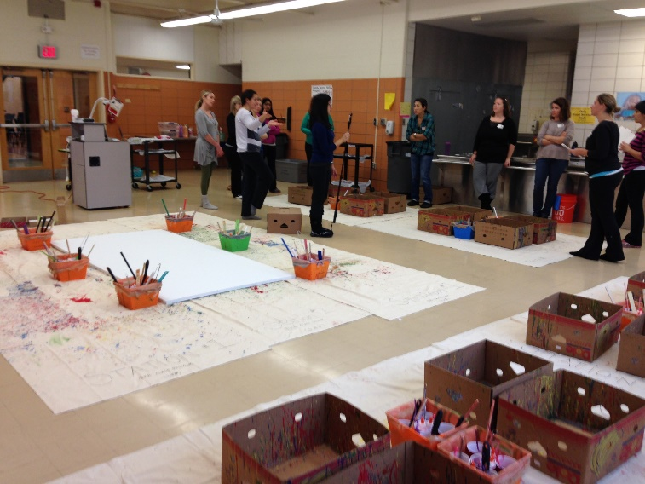
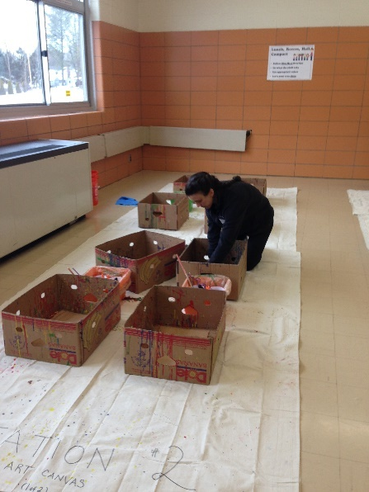
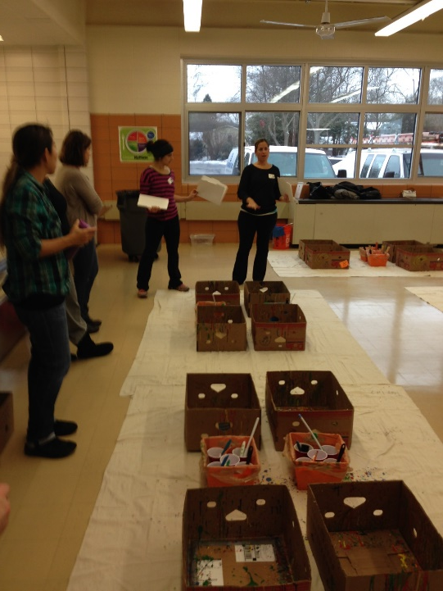
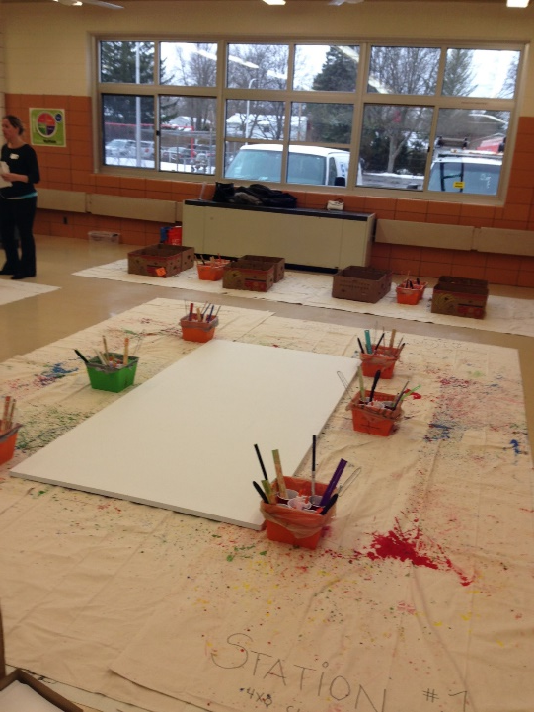
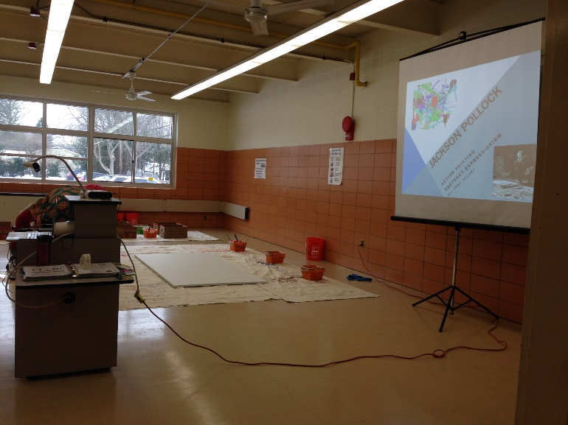
Pics from Park Pollock Project
Cafeteria B

Slide 6
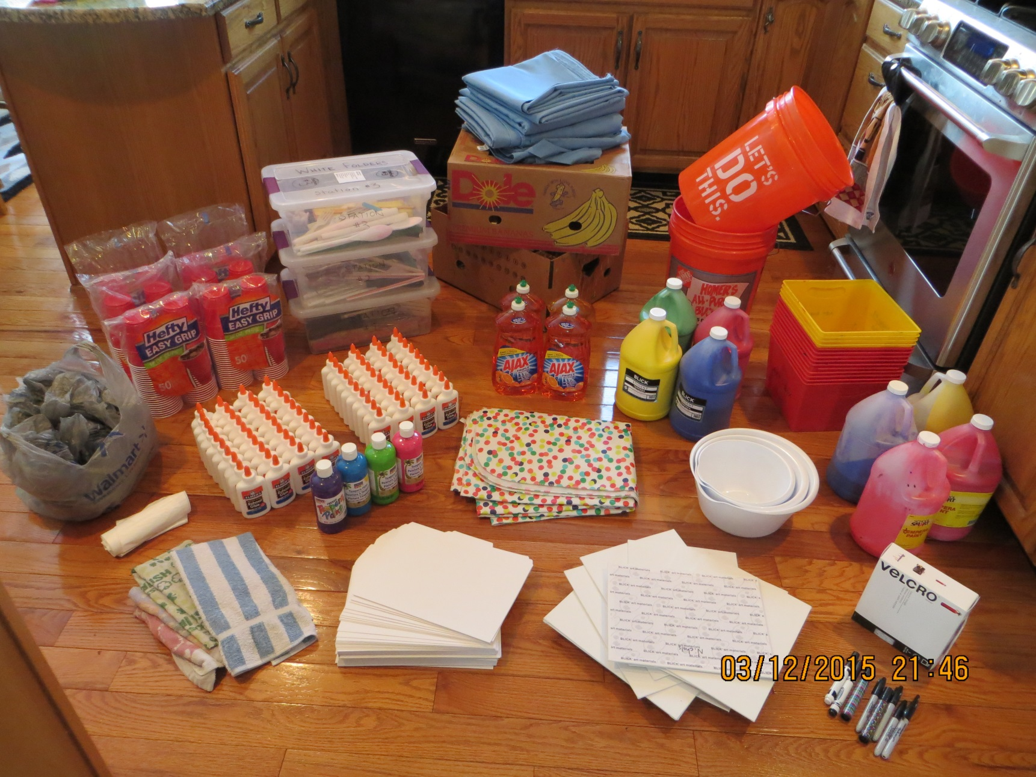
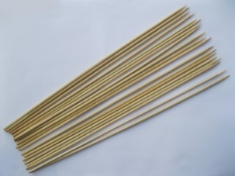
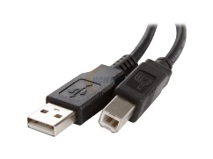
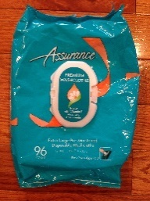
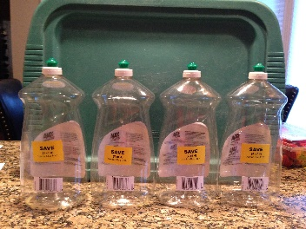
Kindergarten AA: Jackson Pollock
Photo of supplies (see Supply List)
SUPPLIES: 1 of 3
You’ll need:
Bamboo Skewers to do the “drip tests” when prepping paint
(14)
Painters
drop cloths
(3) Home
Depot
buckets
(3)
Station
Tool
BINS
(8) Banana
Boxes
(top & bottom)
Funnel
(for paint prep)
Find in AA bin
CUPS
(4) NEW
Tempera
paint
(14)
Art
boxes
Might need
USB 2.0 cable,
A-male to B-male
for Epson
LOOK FOR or
ASK Art Amb. Chair
(10) AJAX
52 Fl. Oz each
(60)
Wegmans
Bags
(40-60) Elmer’s Glue (depending upon # of students)
(4) Old Gallon
paint containers
marked
“SAVE”
(1-2)
PLASTIC
tablecloths
(2) Packages;
96 count/pkg
Adult Washcloths
12”x8”
Tall kitchen
Garbage bags
(4) Tempera paints
(4) Empty AJAX bottles
marked “SAVE”
(use for glue prep)
towels
or preferably
(6) Blue chamois
WHITE Office
Folders
NOT legal size
(1 per student)
9x12 Artists
Canvas
(1 per student)
Velcro
(2) Sharpie Markers

Slide 7
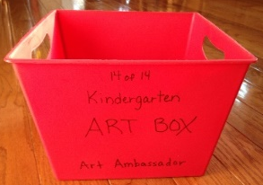
Kindergarten AA: Jackson Pollock
SUPPLIES: 2 of 3
Project Cost $240
WALMART : PLEASE ONLY BUY THESE BRANDS, they are tested and best for any possible allergic reactions
4 fl. Oz. BOTTLES of Elmer’s School Glue: Don’t buy any other brand. “Back to School” pricing $ .50 vs $ .80 each
UNDER 60 STUDENTS: Buy (40) 4 fl. Oz. bottles of Elmer’s School glue
OVER 60+ STUDENTS: Buy (60) 4 fl. Oz. bottles of Elmer’s School glue
(10) 52 FL.OZ of AJAX liquid dish soap (get YELLOW colored one –orange ok) ONLY buy this size AND brand. Other might change paint colors and/or students could have allergic reaction, this brand has been tested).
(280) 18 oz. disposable PLASTIC cups, look like the “Solo” cups
VELCRO (15’) to re-hang the 4-large POLLOCKS back in the Auditorium – give to Custodian Staff
(2) 96 ct. packages of “Assurance” Premium Adult Washcloths 12”x8” (Adult wipes near the Adult diapers)
DICK BLICK: (ORDER AT BEGINNING OF YEAR because they can run out):
(3-4) Packages of 24, white canvas boards (approx. $18 EACH); EACH STUDENT GETS ONE
# 07015-1023 (24/PK) ECONO Canvas Panel 9”x12”
(4) 1-gallon sizes of washable Tempera paint: Green, Blue, Red and Yellow (approx. $50 TOTAL)
AMAZON:
ONE (100) WHITE office file folders (regular size… NOT legal size) ; each student gets one. $18 + shipping.
MICHAEL’S:
(4) 16 fl. oz. of Tempera paint. Any 4-colors; just make them different than the colors in the large gallons. You will use these to tint the glues. In the past: Pink, Turquoise, Purple & Lime Green. MIGHT BE SOME LEFT OVER FROM LAST YEAR, so check first!
DOLLAR TREE: If… any of the ART BOXES breaks… you can buy them at The Dollar Tree for $1.00
OR

Slide 8
Kindergarten AA: Jackson Pollock
SUPPLIES: 3 of 3
Additional Items:
START COLLECTING WEGMANS GROCERY BAGS: You will need (56+) to line EACH of the art boxes when doing the project. They all get thrown away after the class or you’ll have to rinse art boxes.
Need to borrow Art Dept’s LARGE cart with wheels … OR… (4) AV carts to move smaller projects to drying area
KINDERGARTEN AA storage BINS:
LOOK FOR 3’ CORD: Might need USB 2.0 cable, A-Male to B-Male to hook up your Laptop/Tech to School’s Epson Projector
TALL KITCHEN garbage bags; use for smocks if necessary. Also use for covering objects you put smaller projects to dry on.
(8) Banana boxes; they are usually 2-pieces (a TOP and a BOTTOM)
(3) Home Depot buckets to hold 4” of water during project
(14) art boxes
Painter’s drop cloths (14); they get doubled up so the paint doesn’t leak:
(3) 4’x15” canvas drop cloths + (3) 4’x15’ RUBBER drop cloths and (8) 6’x9’ canvas drop cloths.
(4) OLD tempera paint GALLONS that are marked “SAVE” for prepping paint
(4) EMPTY AJAX bottles marked “SAVE” for tinting glue or just use the AJAX bottles you bought this year.
Painting Tools (3 boxes). Each station has different tools. Each box is labeled what’s inside. Please re-check.
Funnel for prepping paint and glue.
Bed sheet and/or (2) PLASTIC table cloth for laying the wet project on when they get set up for drying in the PTSA room.
Couple of BLACK Sharpie Markers: if you don’t get LABELS from teachers, you will need to write each child’s name + TEACHER’s NAME (AM or PM) on the back of each project the children do.
(6) Blue Chamois for wiping up paint during project and wiping off glue bottles inside plastic container
BAMBOO SKEWERS to do several “DIP TESTS” when preparing the gallons of paint.
TO COMPLETE THIS PROJECT, STUDENTS NEED: A SMOCK or wear clothing it’s ok to get paint on and SOCKS (students remove shoes for project)

Slide 9
Kindergarten AA: Jackson Pollock
PROJECT TIMELINE:
ASAP / or by OCTOBER the latest:
Contact Lead Kindergarten Teacher and request they give you a few different days so that you can schedule their grade’s Art Ambassador. Typically done end of January or middle of March. Be sure to schedule over 3-days; with the day in the middle for drying.
Once they tell you the dates, check with Main Office about Cafeteria B and then discuss with your group. Confirm dates & times with LEAD Teacher
Let the Custodian Manager & Cafeteria Manager. know the dates you’ll be in the cafeteria too
BUY ALL SUPPLIES ASAP
PLAN for PREP; lots of glues need to be tinted, (8) Gallons of Paint need prepping, etc.
1-MONTH BEFORE PROJECT:
Post for volunteers; need 4-6; works best with (6) Volunteers for EACH Kindergarten class . Ideally (2) parents at each station.
If an option, school express or Volunteer Coordinator and use an eform if an option. Let them also know dates & times of projects AND TRAINING DATE too.
If an option, contact PTSA Web Leader and request an eform be activated on the PTSA AA page for volunteers. Let them know the dates & times of projects AND TRAINING DATE TOO.
If an option, email Room Parents and request they send email to parents requesting volunteers and include the eform link.
Create Art Boxes and BUNDLE/ORGANIZE all supplies by class.
Figure out your TECH, check for compatibility, do you need a cable, projection screens, etc. and assure it’s all going to work properly.
Make arrangements to TRAIN Parent Volunteers
Determine who will be the Lead AA Person to do the Introduction PowerPoint that students see.
Train Lead AA People: demonstrate project and mention main pointers and/or problems and tell them where supplies are located.
1-2 WEEKS BEFORE PROJECT:
Train Volunteers: demonstrate project, mention main pointers and/or problems and show them where supplies are.
Send email to volunteers to “Thank them for Volunteering”, INVITE THEM TO TRAINING, and include the following:
The times & dates of ALL the grade’s AA projects + times & dates of TRAINING.
If necessary, ask Volunteers to consider covering for other classes if low on volunteers
Attach last few pages of the “Prep” PowerPoint that’s labeled “Volunteer Duties”.
LINK for the video which shows how the project is done.
Email the Custodian Manager (and/or Cafeteria Manager) if you’re near their areas or need anything for the project.
KNOW and TEST YOUR TECH; you probably need 2.0 USB cable for hooking up to school’s EPSON
CHECK TO MAKE SURE YOU HAVE ALL SUPPLIES & ALL PAINTS & GLUES should be PREPPED at this point.
Contact teacher’s and request to have (2) sets of labels with the student’s names (and Teacher’s Name). These will go on the back of the art canvas and on the White File Folders. Easier than writing the student’s names while trying to do the project. Do not stick them to the backs of the folders or artist boards ahead of time!
FIGURE out way of moving all the smaller projects from project room to drying area; borrow Art Cart with wheels & shelves or (4) AV carts on wheels, etc.
SHAKE UP the (4) tinted GLUES and squeeze into the (40) bottles; 10 of each color. Store them on their sides so they don’t separate.
SHAKE UP the (8) gallons of Tempera paint. DON’T STORE IN YOUR GARAGE, they will freeze.
Take all supplies into school and place in storage area.
Email teachers and confirm project (dates & time) AND ASK them to email parents and request they send in smock and/or wear clothing that they can get paint on and to wear SOCKS (shoes are removed). NEVER forget to do this!
To complete project students will need: a smock/clothing they can get paint on & SOCKS (shoes are removed for this project)

Slide 10
TRAINING: 1 of 2
AT TRAINING: Let volunteers know problem spots (YOU TOO):
VIP: HAVE STUDENTS take off their shoes BEFORE the project
Project is done in their socks! Due to Health Laws students need to be in socks, not bare feet.
Ask VOL to take their shoes off too; easier to clean floors and we won’t hurt small toes if we step on them.
Have to remind students their TOOLS should NEVER touch their art
Use (4) RV carts or something with lots of shelves on wheels (art dept might have a cart w/wheels) to move wet projects (FLAT) to the drying area.
Takes 30-minutes to set up:
Lots of paint to be poured. (14) cups of each color – ONLY PUT IN 2” of PAINT!!!!!!!!
Home Depot buckets only get 4” OF WATER
Wegmans baggie placed around each art box
Need (6-8) banana boxes (there are 2-pcs per box; a TOP and a BOTTOM); depending upon how many students in the class.
(4) different colors of glue ONLY go to STATIONS 1 & 2.
Station #3 DOESN’T GET GLUE– white office folders can’t handle the weight
Don’t put LABELS on the folders or canvases YET; too hard to find child name… at project ask child their name, find sticker and stick to their project
Don’t put folders or canvas into the banana boxes ahead of time. Keep to the side, get child’s name, add sticker and then put into the banana boxes.
KIDS are standing at STATION #1, sitting down or kneeling at STATION #2 and #3
You’ll need to use AV carts to move projects (flat) to drying area, be sure to place plastic bags on them to protect from dripping paint
QUICK ROTATION! Three 8-minute rotations – USE A TIMER
Play Jazz music if you can, it was Jackson Pollock’s favorite music.
ONLY PUT 2” of paint in the cups!!! Or… you won’t have enough for all the classes.
Clean up floors with blue chamois as the kids are painting. DON”T WAIT or they’ll track it all over the cafeteria.
Place chamois (2) near each HOME DEPOT buckets, but wring out good! If you add water to Tempera paint, you get MORE tempera paint!!!
END OF PROJECT:
Put station tools into their HOME DEPOT water bucket. Don’t mix them up and go to Custodian room to wash & dry for next use.
Remove glues, wipe off, and re-organize by color for next use.
Bundle up bags in ART BOXES with (4) cups of paint and throw them into garbage container.
Re-organize all tools (dried) back into their correct boxes.
MOVE large Pollock covered in paint carefully! Keep it flat! Must store flat in a room where it can stay for at least 2-days to dry.
Have to be creative to find space for all the student’s art to dry (approx 1-day) in the PTSA & School storage behind stage. Be sure to protect anything underneath projects from dripping paint. Use plastic bags, plastic tablecloths, etc.
Wear shirt, pants and shoes you don’t mind getting paint on!!!

Slide 11
Kindergarten AA: Jackson Pollock
TRAINING:
2 of 2
(3) BINS of TOOLS:
WHEN PAINTING, the student’s TOOL should never touch the project
Each STATION has different tools.
ONCE PROJECT is OVER…. Throw all the tools from one STATION into it’s HOME DEPOT bucket and clean them, dry them, and then return them to their appropriate storage bins.
Notice each bin is labeled with the TOOLS that should be inside.
Tools are subject to change.
STATION #1 TOOLS
4’x8’ CLASS Pollock
Each Station has different tools,
please check to assure there are:
(6) Kitchen Plastic Spoons
(6) Finger Pointers
(6) Large Whisks
(6) Slotted Spoons
(6) Fly swatters
(6) Candles
(6) Wooden Handled BBQ brush
(6) Paint stir sticks
STATION #2 TOOLS
Artist Canvas Board
Each Station has different tools,
please check to assure there are:
(4) Kitchen Wooden Spoons
(4) Small BBQ brushes
(4) Paint stir sticks
(4) Toothbrushes
(4) Spatulas
(4) Smaller Whisks
(4) Baby Spoons
(4) Scoops with LOTS of holes
STATION #3 TOOLS
White Office Folders
Each Station has different tools,
please check to assure there are:
(4) Bubble Wands
(4) Forks
(4) School Pencils
(4) Drink Stir Stix
(4) Combs
(4) Silly Straws
(4) Smaller Spatulas
(4) School Rulers
VIP: NO TINTED GLUES

Slide 12
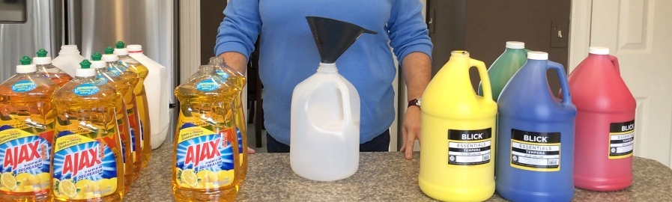
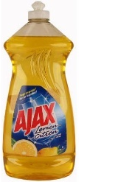
Kindergarten AA: Pollock
PREP: 1 of 2
PREPPING PAINT GALLONS
From (4) NEW gallons you will create a total of (8) gallons of paint; (2) Red, (2) Blue, (2) Green, and (2) Yellow
From AA storage bin get: (1) Funnel and (4) old GALLON paint jugs labeled “SAVE, and (10-12) BAMBOO SKEWERS
From your purchased supplies: (4) NEW Gallons of paint and (8) 52 Fl. Oz. AJAX liquid dish soap in bottles.
You are creating (2) Gallons of the same colored paint:
Open up one of your “NEW” GALLONS of paint that you purchased.
Place funnel into OLD gallon container that is marked “SAVE” and pour ½ of the NEW gallon of paint into it. Do your best to guess at half, just eyeball it if it’s not marked. You now have (2) jugs of the same colored paint; each holding ½ gallon of paint.
Now get (TWO) 52 FL. OZ. bottles of AJAX liquid dish soap.
Using the funnel again…. POUR 1st AJAX into first jug AND pour 2nd AJAX into the second jug.
Re-cap the newly created gallons of paint and SHAKE THEM REALLY WELL! NEVER ADD WATER!
Do a “Drip Test”! Take bamboo skewer (works best) and dip into each gallon of paint. The paint should drip off really fast! If it’s slow or sluggish, start adding 1-cup of AJAX (and do another drip test). Sometimes the paint is really thick (different colors might be different too) and you’ll have to take some out to keep adding 1-cup of Ajax to get the consistency you need.
RINSE FUNNEL and REPEAT for each of the remaining paint colors.
Store these paints in a dry, warm area ---- NOT THE garage they will freeze!
Each class will use approximately ½ GALLON of each paint color.
IF… you get LOW on PAINT and need a little more, just add more AJAX, never WATER!
FYI: AJAX makes the paint shiny, makes it stick better, makes it runny and more washable.
MOST IMPORTANTLY, the paint won’t get mold due to Ajax.
Once project is over, rinse out gallons marked “SAVE” and store for next year.
VIP
Drip Test
#1
#2
Step 2
Step 3
Step 4
Step 5
Step 6

Slide 13
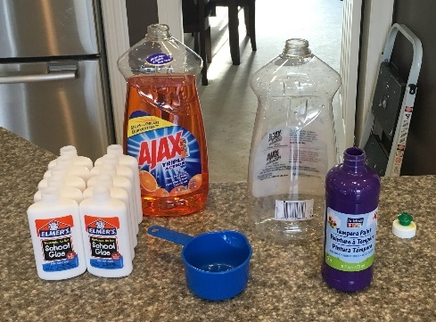
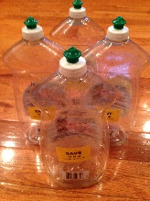
PREP: 2 of 2
(K) AA:
Do this about 1-week before project. If you do it too far ahead of time the glue & AJAX will separate and
you have to shake 40 bottles of glue OR…. Prep early and leave the tinted glues in the AJAX containers
and shake before you re-fill the glue bottles closer to project time. Don’t throw away (40) glue bottles!
(40) TINTED GLUES (if under 60 students): Gives you 10-bottles of each color.
(60) TINTED GLUES (if 60+ students): Gives you 15-bottles of each color. Make up the (40) bottles as described. Then make remaining (5) sets of each color and re-fill bottles as needed.
Preparing
TINTED GLUES:
FROM AA STORAGE BIN find:
Funnel and (4) EMPTY AJAX squeeze bottles marked “SAVE”
HOPEFULLY YOU HAVE: 1-cup measure
FROM the supplies you bought find:
(40) glue bottles, (1) bottle of new AJAX, and (4) smaller Tempera paints
Pour 1-cup of AJAX liquid soap into ONE of the EMPTY Ajax squeeze bottles.
Drain (10) bottles of glue into the same AJAX squeeze bottle.
Pick one of the smaller Tempera paints (16 oz.) (pink , lime green, turquoise or purple) and give it FOUR good squeezes into the same Ajax bottle. Don’t keep adding more paint color, glue only turns so much.
SHAKE IT UP REAL GOOD until the liquid soap, glue, and paint are all mixed together.
NOW…. You can easily re-fill the (10) glue bottles or wait until the closer to project and then re-fill, just don’t throw the (40) glue bottles away!
REPEAT: Now create the 2nd, 3rd, and 4th colors following the same steps. Once all re-filled, rinse out remainder glue & store squeeze bottles.
40 bottles of Tinted Glue
10 of EACH color
(10) Turquoise
(10) Pink
(10) Purple
(10) Lime

Slide 14
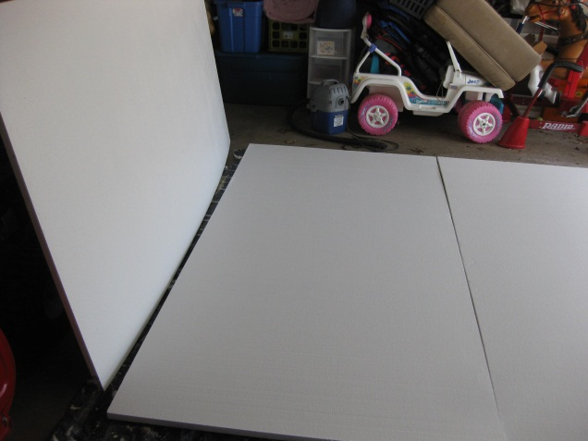
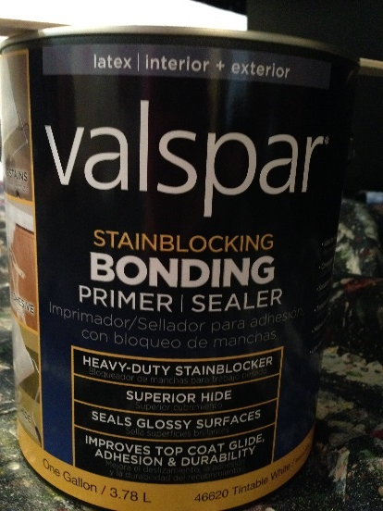
Kindergarten AA: Jackson Pollock
TO ADD/REPLACE: 4’x8’x1” FOAM BOARDS in Auditorium
FYI: This project re-uses the (3-4) large Class Pollock’s that are hanging up in Auditorium.
These canvases get better with each year’s layering. Very much like Jackson Pollock did to create his pieces.
IF EVER… it becomes necessary to add (add’l class) and/or start again:
Buy 4’x8’x1” square edge foam insulation boards from Lowe’s; in the past Macedon Lowe’s has sold us these at their cost.
Buy 1-gallon, Valspar BONDING PRIMER from Lowe’s
Use paint roller, apply 2-coats of primer on top AND all four edges
DRY thoroughly in between coats, approximately 2-days
Write Teacher’s name on the side edge of the foam
Then you can start splatter painting on them
$16 each ($10 their cost)
$25 ($12 their cost)
Needs (2) coats

Slide 15
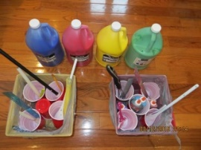
Kindergarten AA: Jackson Pollock
Project (1-hr) + Training & Set-up (40 min) + Clean Up (15 min)
PROJECT OUTLINE:
LEAD AA Person
(1 of 2)
SET-UP: Arrive 45-min. to 1-HOUR BEFORE scheduled project to manage materials, set up for the Cafeteria
ASAP: Connect your LAPTOP to the School’s tech (projector or portable projector) + screen; had to download PP from PTSA website
Set up drop cloths for each station (there are 3-stations); they need to be DOUBLED up, see ROOM layout
Set up and pour paints, see Volunteer instructions
Set up (14) art boxes, see Volunteer instructions
Set up banana boxes (there are 8 banana boxes, separate them and place each piece per NEXT page layout)
Set up tools (there are 3-bins) see Volunteer instructions
Set up glues (only in Station #1 and #2) see Volunteer instructions
NEED to place Large Class Pollock onto middle of Station #1
Need to put Art Canvas boards at Station #2 (don’t put them on ground or they’ll get painted)
Need to put White Office Folders at Station #3 (don’t leave on the ground)
Should have (2) sets of labels with student’s names at Station #2 and #3 (do not stick them on in advance!)
There should be (2) VOLUNTEERS at each station once the project begins
Need to time 8-minutes between the rotations, give VOL 1-minute warning, keep students organized in their station, there will be 3 movements
Play JAZZ music on your PC if you can, it was Pollock’s favorite music
IF getting low on paint… ADD AJAX liquid dish soap (NEVER WATER) to make more paint.
Student’s painting tools should NEVER touch the project, just like Jackson Pollock did.
After EACH rotation, student projects should be placed FLAT to the side or moved away on rolling carts to the area where they will dry for 1-day.
INTRODUCTION: Jackson Pollock PowerPoint Introduction (10 minutes) might be done in Cafeteria or Auditorium
PROJECT: Step 1:
Ask Teacher to split students into (3) groups; send ONE group to each of the three stations
TIME STATIONS 8-MINUTES TO PAINT! Clean up paint on floor with DAMP blue chamois
Give 1-MINUTE WARNING before time is up so Volunteers can clean floors before rotation.
Step 2:
ROTATE students to their next stations ; Follow ROTATION schedule
TIME STATIONS 8-MINUTES AGAIN TO PAINT! Clean up paint on floor with DAMP chamois
Give 1-MINUTE WARNING before time is up so Volunteers can clean floors before rotation.
Step 3:
ROTATE students FOR THE LAST TIME, Follow same ROTATION schedule
TIME STATIONS THEIR LAST 8-MINUTES TO PAINT! Clean up paint on floor with DAMP chamois
Give 1-MINUTE WARNING before time is up so Volunteers can start cleaning floors
CLEAN-UP: Remaining 10-15 minutes of project… CLEAN UP STUDENTS.
Give them Adult Wipes and help clean them up.
Tell students to return to area where they saw Introduction and collect their shoes.
Ask students which tools they liked the best? Ask what did they learn from AA?
Ask students to “Thank Volunteers” and to “Thank their Teacher too for letting us have 1-hour”
While this is being done… Volunteers should do the following:
Gather tools into their Home Depot bucket, rinse off, return to correct bin
Collect glues and wipe them off and put them in a bag for next class
Tie up plastic bag, with remaining cups of paint AND THROW AWAY
Put banana boxes back together again
Fold up tarps
Do a final wipe down of the floor with the blue chamois
STUDENT ROTATION:
Station #1 always moves to Station #2 (Class Pollock to ART CANVAS)
Station #2 always moves to Station #3 (Art Canvas to WHITE OFFICE FOLDERS)
Station #3 always moves to Station #1 (White Folders to CLASS POLLOCK)
Volunteers at
Stations #2 and #3
will place student labels on back of each project. Do not pre-stick them. Only stick labels after student tells you their name!

Slide 16
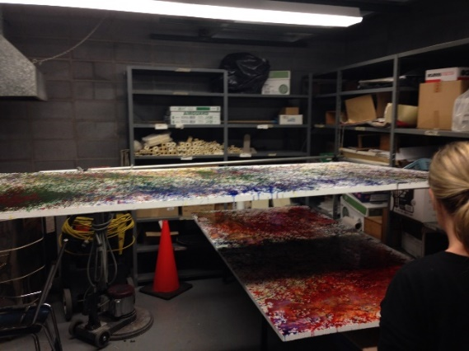
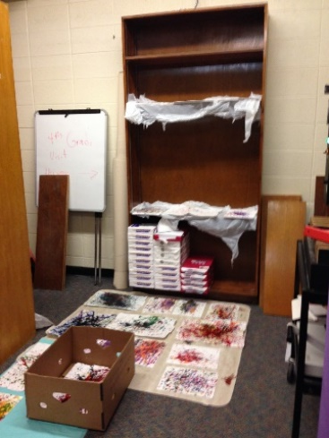
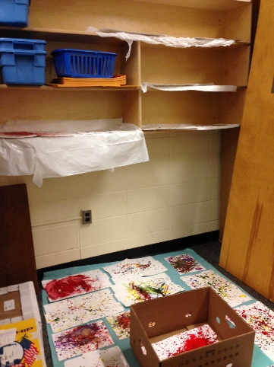
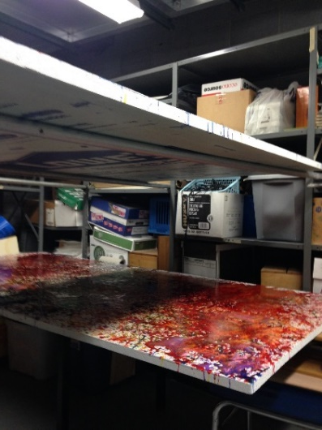
Kindergarten AA: Jackson Pollock
PROJECT OUTLINE:
LEAD AA Person
(2 of 2)
ONE DAY AFTER PROJECT(S):
The ART CANVAS and OFFICE FOLDERS will be dried within 1-day
Match up each student’s Art Canvas & Office Folder; place the canvas inside the folder.
Return projects to appropriate Teachers.
THE LARGE CLASS POLLOCKS (4’x8’) take about 2-days to dry. Keep them flat until they are dried!
Once the (3-4) LARGE POLLOCKS are dried…. give the Custodians the new VELCRO you purchased and ask that they hang them back up in the Auditorium.
CHECK organization of tools for the (3) stations, make sure nothing is missing OR put in the wrong container.
GIVE ALL tinted GLUES to art department
MAKE SURE YOU SAVE the (4) paint gallons that are labeled… “SAVE” --- empty them and throw the rest away
Store everything for next year; prep tools, all tarps, banana boxes, tools, buckets, left over supplies.
Custodian MGR at Park built small temporary scaffold so (2) Large 4x8 could lay flat to dry at the same time in Closet with Kiln.
PTSA storage area and attached School supply area

Slide 17
Station #2
(2) 6’x9’ drop cloths laid on
top of (2) other drop cloths
KEY:
(14) drop cloths (they are doubled up)
(6-8) Banana Boxes per station:
depending upon # of students
(3) Home Depot buckets + (6) chamois
(14) Art Boxes
HD
+ (2) chamois
Exit to bathrooms
Tarps
4’x8’ Class Pollock
HD
Station #1: (3) 4’x15’ RUBBER drop cloths on bottom
with (3) Canvas drop cloths on top
HD
Wall
+ (2) chamois
Station #3
(2) 6’x9’ drop cloths laid on
top of (2) other drop cloths
Students will take
shoes off
and sit here for
Pollock Intro
and then return here after
project to clean up.
Epson on CART
Projector Screen
Start
Place
drop
cloths
HD
+(2) chamois
Pour
Paint
only 2”
Make
(14)
Art Boxes
Mendon Center Elementary
Kindergarten Art Ambassador
AA Lead & VOLUNTEERS
Cafeteria Room Layout & Set-Up Pyramid
Place
(6-8)
Banana
Boxes
Put 2”
Water in
Home Depot
Buckets
Place
Tinted
Glues
Place
Station
TOOLS
Class
4’x8’
Foam Board
Station #1
Artists
Canvas
Boards
Station #2
White
Office
Folders
Station #3

Slide 18
KEY:
(14) drop cloths (they are doubled up)
(6-8) Banana Boxes per station:
depending upon # of students
(3) Home Depot buckets + (6) Chamois
(14) Art Boxes
HD
+ (2) chamois
5 ft.
Portable Projector Screen
+ (2) chamois
9 ft.
Tarps
Students will take
shoes off
and sit here for
Pollock Intro
and then return here after
project to clean up.
HD
4’x8’ Class Pollock
HD
Podium
(Epson)
Heat Register
Station #1: (3) RUBBER drop cloths on bottom
Plus (3) Canvas drop cloths on top
WINDOWS
Doors to Cafeteria B
Station #2
(2) 6’x9’ drop cloths
laid on top of (2) others
Station #3
(2) 6’x9’ drop cloths
laid on top of (2) others
Start
Place
drop
cloths
Cafeteria B Lunch Line
HD
+(2) chamois
Pour
Paint
only 2”
Make
(14)
Art Boxes
Park Elementary
Kindergarten Art Ambassador
AA Lead & VOLUNTEERS
Cafeteria B Room Layout & Set-Up Pyramid
Place
(6-8)
Banana
Boxes
Put 2”
Water in
Home Depot
Buckets
Place
Tinted
Glues
Place
Station
TOOLS
Class
4’x8’
Foam Board
Station #1
Artists
Canvas
Boards
Station #2
White
Office
Folders
Station #3

Slide 19
KEY:
(14) drop cloths (they are doubled up)
(6-8) Banana Boxes per station:
depending upon # of students
(3) Home Depot buckets + (6) Chamois
(14) Art Boxes
Projector Screen
Entrance to Cafeteria
Tarps
HD
Students will take shoes off and sit here for Pollock Intro and then return here after project to clean up.
Station #3
(2) 6’x9’ drop cloths laid on
top of (2) others
HD
Podium
(Epson)
Cafeteria Lunch Line
HD
Station #2
(2) 6’x9’ drop cloths on
top of (2) others
Station #1:
(3) 4’x15’ RUBBER drop cloths on bottom with
(3) 4’15’ canvas drop cloths on top
4’x8’ Class Pollock
Start
Place
drop cloths
HD
Entrance to Cafeteria
Pour
Paint
only 2”
Make
(14)
Art Boxes
Thornell Elementary
Kindergarten Art Ambassador
AA Lead & VOLUNTEERS
Cafeteria Room Layout & Set-Up Pyramid
Place
(6-8)
Banana
Boxes
Put
2” water in
Home Depot
Buckets
Place
Tinted
Glues
Place
Station
TOOLS
Class
4’x8’
Foam Board
Station #1
Artists
Canvas
Boards
Station #2
White
Office
Folders
Station #3

Slide 20
Kindergarten AA: JACKSON POLLOCK
Volunteer Duties: 1 of 3
PROJECT OUTLINE:
Project is 1-hour, with an additional set-up of 30-40 minutes + 15 minute clean up.
Students will remove their shoes and then see an Introduction PowerPoint of Jackson Pollock (10-minutes)
After Introduction, students will be put into 3-groups and directed to one of three stations. (2) Volunteers per station works best.
There will be (3) stations that students rotate through in CAFETERIA “B”:
Station #1: 4’x8’ Class Pollock (students STANDING)
Station #2: Art Canvas Boards (students sitting or kneeling)
Station #3: White Office Folders (students sitting or kneeling)
Instructions for volunteers and students will come from Art Ambassador Lead.
There will be (3) ROTATIONS, that will be timed at 7-MINUTES each, a timer will be used.
AA Lead will give you 1-minute warning and you will do a quick clean up of paint on the floor around your station with the blue chamois.
About 15-minutes BEFORE end of project we’ll return students to where they saw Introduction and give them wipes to clean up.
Most volunteers will start clean up duties at this same time.
MOST IMPORTANT:
PLEASE arrive 40-minutes BEFORE scheduled project to help with setting up.
Volunteers should wear clothing they don’t mind getting splattered with PAINT. PLEASE take your shoes off!
IF a student doesn’t have a smock or needs to cover clothes; take kitchen garbage bag and rip/cut a hole for their head and arms.
VIP: BEFORE students paint at Stations #2 and #3… ask their name and FIND THEIR LABEL (stick to back of canvas or folder’s tab), then place INSIDE banana box. Please do not pre-stick their labels.
PLEASE remind students that their tools, should NEVER touch any of their art.
There are THREE, 8-minute rotations – A TIMER will be used. Station #1 moves to #2, station #2 moves to #3, station #3 moves to #1…. etc.
VIP: PLEASE ONLY POUR 2” of paint into the cups. Assures we have enough paint for all classes and less of a mess.
STATION #3… Does NOT get tinted glues. It’s too heavy for the office folder and would ruin them.
Clean up floors with blue chamois while kids are painting. Use water in bucket, but wring out chamois. Adding water to Tempera paint, you get MORE tempera paint!
ALL VOLUNTEERS: clean up ALL paint that gets on WALL, FLOOR, HEATER, etc. using blue chamois throughout the project
VOL at Station #1: might have to move a student(s) to a different spot on the LARGE canvas if they are a little heavy handed on splattering.
VOL at Stations #2 and #3: if student(s) get heavy handed with paint, suggest they try another tool

Slide 21
Kindergarten AA: JACKSON POLLOCK
Volunteer Duties, SET-UP: 2 of 3
(2) VOLUNTEERS: SET UP (see Room Layout)
STEP ONE: Do this ASAP
Get (14) DROP CLOTHS; see layout of room
(4) 6’x9’ at Station #2 – they are doubled up, one on top of the other
(4) 6’x9’ at Station #3 – they are doubled up, one on top of the other
(6) 4’x15’ at Station #1 – place the (3) that are like rubber sheets on the bottom and layer the (3) 4’x15’ on top. Slightly overlap the layers
STEP TWO
Get (6-8) BANANA BOXES
Depending upon # of students in classroom, adjust to need
Separate the banana boxes; 1 per each student at the station
Place (6 or 8) boxes at Station #2, see room layout
Place (6 or 8) boxes at Station #3, see room layout
STEP THREE
Get (4) Home Depot buckets + (8) Chamois
Take buckets to Janitorial closet near Cafeteria A, and fill with about 4” of water
Place one bucket at Station #1 and #3, Station #2 gets TWO buckets.
Place two BLUE CHAMOIS near each Home Depot bucket
(2) VOLUNTEERS: SET-UP ART BOXES
STEP ONE
Get (14) “Art Boxes”, brightly colored squares
Get (14) Wegmans bags and place around each art box (like garbage can)
STEP TWO
Place (4) cups of paint (Green, Blue, Red & Y) into EACH art box
Get (14) EMPTY plastic cups and place in center of EACH art box (helps to keep the paint balanced in boxes)
STEP THREE
Get the (40) tinted glues; there are 4-colors (10 of each color)
Unscrew the glue caps, so they will flow
Place one of each glue color in & around CENTER cups of the Art Boxes at Station #1 and Station #2 ONLY.
Take (10) art boxes with GLUE: (6) to Station #1 and (4) to Station #2
Take (4) art boxes WITHOUT GLUE to Station #3
See Room Layout.
NO TINTED GLUES at station #3 (office folders) !!
(2) VOLUNTEERS: POUR PAINT and get 4’x8’ foam board
STEP ONE: Do this ASAP
Get (56) plastic cups TOTAL
Pour 2” of GREEN paint into (14) cups
Pour 2” of YELLOW paint into (14) cups
Pour 2” of RED paint into (14) cups
Pour 2” of BLUE paint into (14) cups
WHEN DONE… Give all paint cups to BOX VOLUNTEERS
STEP TWO:
Get CLASS POLLOCK 4’x8’ foam board (it’s light, CAREFUL
Place in center of STATION #1 for students to paint
(1) VOLUNTEER: PAINTING TOOLS
Get (3) containers of TOOLS (they are labeled Station #1, Station #2 and Station #3
Each Station has it’s own specific Tools.
Bring Station #1 tools to Station #1 and place (2) TOOLS into EACH CUP of PAINT.
Do the same for Station #2 and #3.
You should use all the tools in the container

Slide 22
Kindergarten AA: JACKSON POLLOCK
Volunteer Duties, CLEAN-UP: 3 of 3
VOLUNTEER CLEAN UP DUTIES
& RETURN SUPPLIES to PTSA storage
(1) Volunteer – STUDENT CLEAN UP
After project, students will go back and sit in area where they saw the Introduction
Please give each student 2-3 wipes and help them clean up their hands and face.
Have students find their shoes and put back on.
(2) Volunteers – TOOLS
Collect tools from Station #1 by putting them into the Station #1 Home Depot bucket, do the same for other tools at their stations.
Take (3) buckets into the Janitor closet (near Cafeteria A) to rinse off paint, dry, and store back into tool containers (note they are marked with which TOOLS go into which containers. Thanks for keeping them organized!
(1) Volunteer – GLUE
Collect all glue.
Close the caps and give them all a good wipe down (use chamois or rag)
“Quick Check” to see if any of the glues are LOW… If so, please give these bottles to Lead Art Ambassador so they can re-fill. THANKS!
Put all others back into the bag for next class use.
(1) Volunteer – Art & Banana BOXES
Tie all Wegmans bags that are in art boxes (with paint cups inside) and throw away in the lined garbage bin.
Put all the banana boxes back together again; their tops with their bottoms and take back into the PTSA storage area.
(1) Volunteer – ROOM CLEAN UP
Fold up drop cloths: Keeping them doubled, please fold in half (with paint on the inside) then in half again and place in LARGE grey storage container.
Floor clean-up: look for any paint left on the floor and use chamois to clean up
FINAL:
Keeping it FLAT… MOVE large CLASS 4’x8’ Pollock down hallway to Janitor closet. Place one tarp over threshold, tip it REAL QUICK and lay flat to dry.
You will have to be creative to find space for all the student’s art to dry (approximately 1-day) – use rolling carts and go to PTSA storage area and floor.

