Slide 1
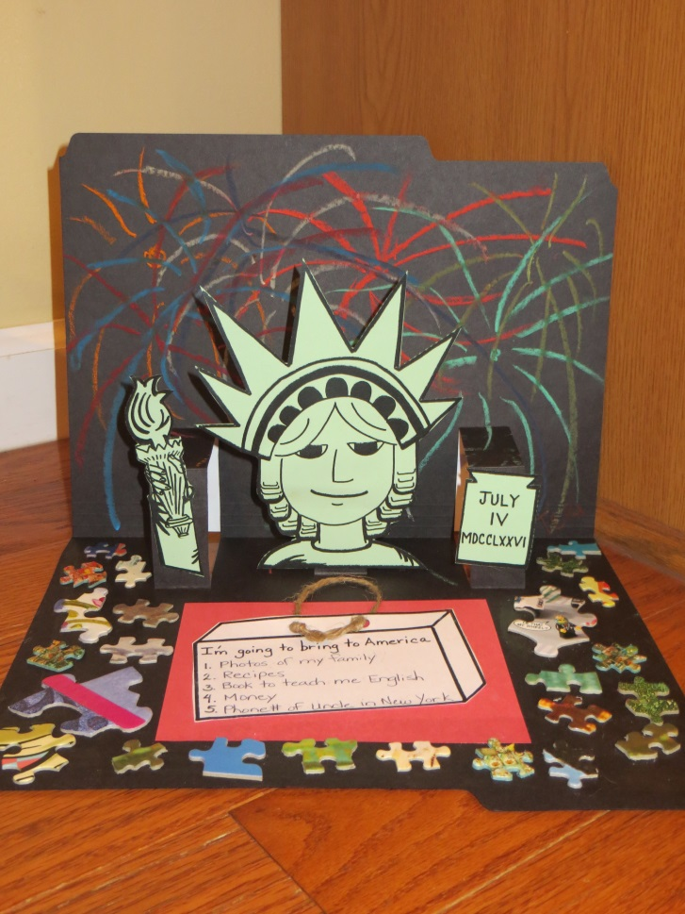
4th grade Art Ambassador: Immigration/Sabuda
Pittsford PTSA
“IMMIGRATION”
in the pop-up book style of
Robert Sabuda
By Teri Allart
Includes Supply List, Project Time Line, Prep photos, Outline, and Project Duties.
Ties into 4th grade’s IMMIGRATION unit.
Students will create a Statue of Liberty pop-up against a firework filled night sky. It will focus on Robert Sabuda’s book, “America the Beautiful”, and will require students to think about what tangible items to bring to America and intangible items (their special talents). The inside of the piece is decorated with puzzle pieces which represent all of the different people here in the USA; different size, colors, religions, beliefs, etc. and how we fit together.
Buy Supplies ASAP
Plan for PREP ASAP

Slide 2
PLEASE READ
District Art Ambassador (AA), Pittsford PTSA
PLEASE READ
These PowerPoint presentations for “Prep” and “Introduction” were written and designed by Teri Allart. A parent from Mendon Center Elementary who became Chair at MCE and was asked to become District Art Ambassador to bring her projects to the other Elementary schools of Pittsford.
As you read through, please check with your PTSA Chairperson to see how your school does things especially as it relates to Recruiting & Training.
Recruiting for Parent Volunteers (possible options): You will need to figure this out…
  Sign up sheets. Typically done at the beginning of the year, listing email addresses. PTSA Chairperson for your school hopefully has.
  “Volunteer Coordinator” for your school. Might handle all the recruiting for you.
  Might designate someone on your team to handle all matters with seeking Volunteers.
  Weekly PTSA e-mailer: can put a shout out to parents about seeking Volunteers.
  School Web Editor and/or Webmaster might be able to add in the school’s e-mailer that AA is looking for Parent Volunteers. Hopefully, might be able to add a live link to allow parents to easily click to become a Volunteer.
  Email Room Parents and request volunteers for the project.
Training:
Go to: Pittsford PTSA website / select your school / ART AMBASSADOR / click the grade and at the bottom will be the following:
    (2) PowerPoints: (1) “Prep” for AA Chair/Lead AA and (1) is the “Introduction” (students see this PowerPoint in classroom). Backups of these are located on Google Drive or hard drive of the AA Chair. Need to download and be familiar with these in order to prepare for the project.
    VIDEO: created by Amy Klinsky and Teri Allart showing prep for the project and a demonstration of the project.
  The best way is to train Parent Volunteers is about 1-week before the actual projects.
  The “Prep” PowerPoint mentioned above is printed out and inside the “Master” Art Ambassador book.
  Send last few pages of the “Prep” PowerPoint to all Parent Volunteers, that are labeled “Volunteer Duties”
Tech:
  Each school has different tech, so be sure to figure out how you are going to show the “Introduction” PowerPoint to the class.
  Smartboard with Elmo OR Portable Projection both need a PC. If in the regular classroom usually we use the teacher’s PC, they will need to be able to access Pittsford PTSA website. Anything outside of that will need your laptop or you might be able to borrow one from school.
  Download the (2) PP’s or get access to your Art Ambassador’s Google Drive. Need to have the “Prep” + “Introduction” PowerPoint (student’s see).
  ALWAYS check Tech way before the project. Might need a special cable, tech changes all the time. Always check your tech!
  You might need an ELECTRICAL CORD so you can move Tech around the room. Can ask Custodial Manager for one.
Room Layouts: Any and all layouts shown are suggestions only.
Room Usage Form:
  When doing projects outside of the Teacher’s classroom, check to be sure of the room’s availability with the Main Office first. If ok’d, complete “Room Usage Form” (i.e., Cafeteria, Staff Cafeteria, Training Rm, etc.) and list all dates & times of use. You will also put any needed items; tables, portable tech, electrical cord, etc. for the Custodial department.
The guidelines of this project are written for use by the Chair Art Ambassador and/or Lead AA. Always check to see what your school has done in the past and follow, especially as it relates to the above items. As times changes and with new PTSA people, details of the above will most likely change too.
Presently, the District Art Ambassador is Teri Allart and the email to request PowerPoints is ptsa.artambassador@gmail.com. Other Pittsford Elementary AA’s are: mceartambassador@gmail.com , prartambassador@gmail.com , aceartambassador@gmail.com , treartambassador@gmail.com
2/2016

Slide 3
4th grade AA – Immigration / Robert Sabuda
Most Important:
Scheduling:
  This project can be done within the Teacher’s classroom.
  Classes can be scheduled back to back, with a 15-minute window needed in between classes.
  JANUARY: Contact Lead Teacher to schedule at a time when hopefully the students are doing their IMMIIGRATION unit.
  If doing projects outside of Teacher’s classroom, Main Office, Custodial Mgr and/or Cafeteria Mgr. need to know the dates of the project & times too.
Logistics:
  BE FAMILIAR with PREP PowerPoint and INTRODUCTION PowerPoint (students see in classroom) AND watch VIDEO to see prep and demonstration of the actual project. Find all by going to: Pittsford PTSA website / SCHOOL (select your school) / click on Art Ambassador / (select the grade).
  Works best with (3-4) Volunteers PER CLASS
  Need to make a KIT; one for each student: Black office folders (inside): Abilities Page + Suitcase + Red/Blue construction paper + Statue of Liberty GREEN STOCK
  BE SURE TO BRING: America the Beautiful – pop-up book by Robert Sabuda to the PROJECT to show students.
  Bring SAMPLE of project to all classes.
  Students will create a statue of Liberty pop up against a firework filled sky. Inside they will write (5) tangible things they’d bring to America (passport, money, NO TECH!, medicine, etc), decorate with puzzle pieces (that represent our differences in the people of the USA; race, color, size, religion, beliefs, etc) and on the front will list abilities that they’ll bring to America (the intangible things; math ability, good at soccer, cooking ability, great at running, etc).
  FIGURE OUR YOUR TECH…. screens, cables, laptop, Epson, school’s computer, etc. is it working and/or compatible?
  Need to download & review: Immigration/Robert Sabuda “Introduction” PowerPoint AND “Prep” for AA Chair/Lead AA (printed off in the Master AA book).
  Student’s will watch the Immigration/Robert Sabuda “Introduction” PowerPoint during the project.
  While students are older; they’ll need some help coming up with intangible things, their abilities which go on the front.
  During project, AA Lead Person will also give students “State of Liberty Trivia”
  4th grade’s AA VIDEO(S) to watch how the project is done is available at: (TBA)
Supplies & Prep:
  BUY SUPPLIES ASAP. Don’t wait until you’re closer to the project. Buy the right BRAND and AMOUNT! Check grade’s AA bin for left over supplies
  PREP ASAP and eventually organize all by bundling for each class.
  To complete this project students will need: scissors, glue sticks, BLACK ink pen and colored pencils.

Slide 4
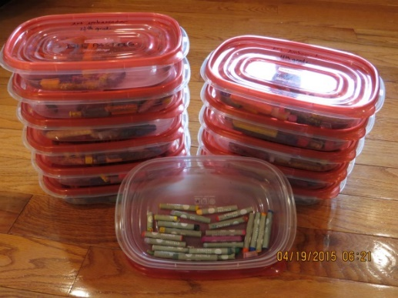
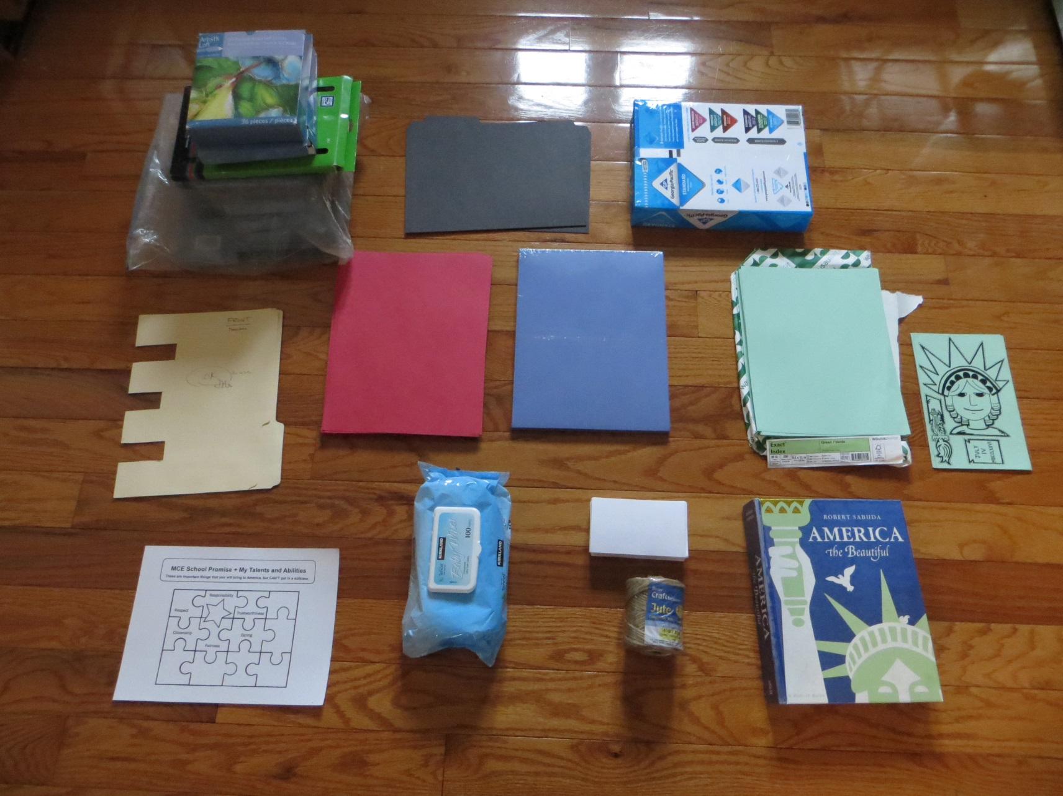
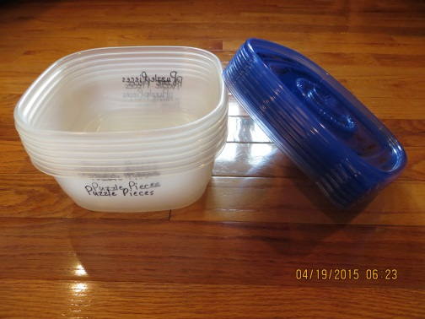

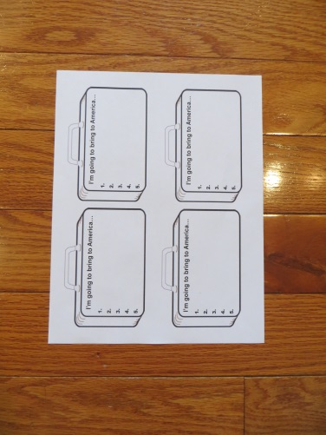
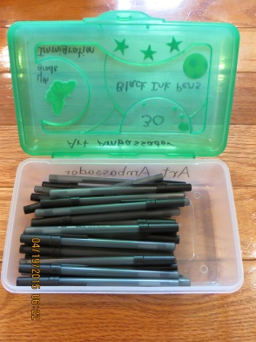
4th grade Art Ambassador: Immigration / Robert Sabuda
Supply Photo:
LOTS of PUZZLE PIECES in a bin
(9-12) Containers
Oil Pastels
(6) containers for puzzle pieces
Black Office File Folders
White regular copy paper
Statue of Liberty
pop-up
TEMPLATE
FIND WHITE MASTER COPY
or PDF!
Red construction paper
Blue
construction paper
Green stock paper
MUST BE
(90 lbs.)
(2) File Folder
TEMPLATES
Follow to cut back (not out) the TABS on black office folders
(30) Black ink pens
(3) packages
wipes
Pop-up Book in special container
Suitcase MASTER
COPY
Also a PDF
“Special Talents”
MASTER COPY
Also a PDF

Slide 5
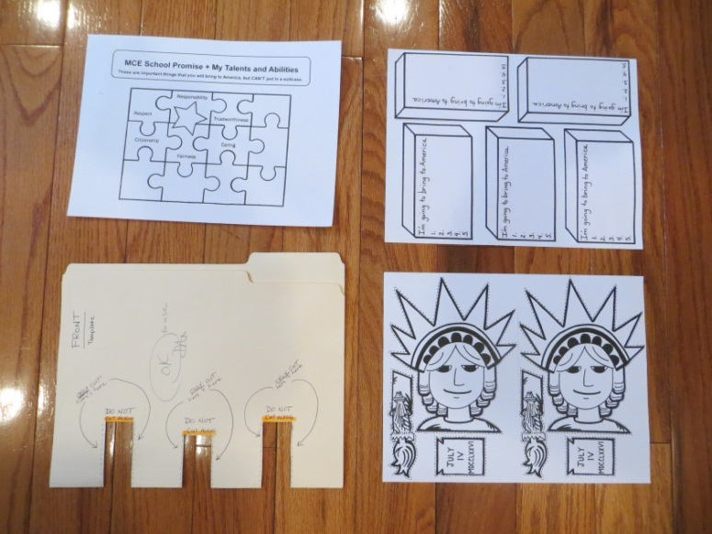
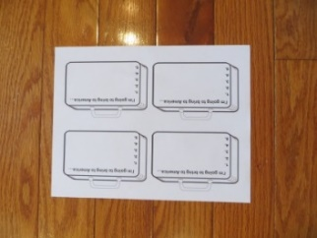
4th grade AA: Immigration/Sabuda
SUPPLY LIST:
AMAZON:
  (1-2) packages (100/box): BLACK office folders: (1) for each student
    FYI: You can buy regular manila folders but you will need to buy A LOT OF GLUE, black paper; cut it and glue it to all of the folders. It’s less expensive to buy the BLACK OFFICE FOLDERS.
  (1) package, must be 90 LB. GREEN CARD STOCK PAPER -250 sheets: Statue of Liberty green, NOT dark green
WALMART:
  (2) LARGE WIPIES; for each student to clean their hands after they use the oil pastels.
  OIL PASTELS (if you need to add/replace current supply)
  Small package of glue sticks; project is done at the end of the year… student’s are usually out.
MICHAEL’s: (check first to see if there is any left over from last year).
  1-package, Red construction paper
  1-package, Blue construction paper
SAVER’s in Henrietta / THRIFT STORES:
  If you need more puzzle pieces. They may donate or you
  can buy them cheaply. Take out any that area REALLY BIG!
LOOK IN GRADE BIN or AA shelf:
  SAMPLE of project
  Robert Sabuda’s pop-up book, America the Beautiful
  Puzzle pieces (storage container)
  OIL PASTELS crayons (9 boxes)
  BLACK ink pens; 1 per student (don’t use pencils, they’ll smudge)
  See if any red or blue construction paper is left over.
  (2) OFFICE FOLDER templates
  Statue of Liberty Master Copy (WHITE with 2-Liberty heads)
  “Suitcase” Master Copy
  “My Special Talents & Abilities” Master Copy
TO COMPLETE THIS PROJECT STUDENTS WILL NEED: Glue Stick, Scissors, Black ink pen & Colored Pencils
Office Folder template (bottom left)
and (3) Master Copies also in PDF form

Slide 6
4th grade AA: Immigration/Robert Sabuda
PROJECT TIME LINE
JANUARY:
  Check for left over supplies in the grade’s AA container first and then purchase needed supplies NOW.
  Plan for PREP ASAP and delegate to Volunteers
  Determine a TRAINING date and complete Room Reservation Form if you’re doing TRAINING in a room.
  Typically this project is done in the regular classroom. It can be scheduled back to back with a 15-minute window.
  If doing project outside of regular classroom; after getting dates from Lead Teacher, check with Main Office the room’s availability, then confirm back with the Lead, and complete Room Reservation form.
  If outside of the classroom, let Custodian Mgr. and/or Cafeteria Mgr. know you will be in a room on the dates of the project.
  Send (3) PDF’s to Printer @ Barker Rd Middle School ASAP, don’t wait! He gets busy!
      Double Liberty Head –needs to be printed on 90 LB, MINT GREEN CARD STOCK (order from Amazon ASAP); 1 per student
      Suit case (white paper, 1-per student)
      Abilities Page (white paper, 1-per student)
MONTH BEFORE PROJECT:
  Post for volunteers; works best with (3-4) Volunteers; school express or Volunteer Coordinator and use an eform if an option. Let them also know dates & times of projects AND TRAINING DATE too.
  If an option, contact PTSA Web Leader and request an eform be activated on the PTSA AA page for volunteers. Let them know the dates & times of projects AND TRAINING DATE TOO.
  If an option, email Room Parents and request they send email to parents requesting volunteers and include the eform link.
  All prep should be done by this point.
  BUNDLE/ORGANIZE all supplies by class.
  Figure out your TECH, check for compatibility, cables, screens, etc. and assure it’s all going to work properly.
  Make arrangements to TRAIN Parent Volunteers
  Determine who will be the Lead AA Person to do the Introduction PowerPoint.
  Train Lead AA People: demonstrate project and mention main pointers and/or problems and tell them where supplies are
1-2 WEEKS BEFORE PROJECT:
  Train Volunteers: demonstrate project, mention main pointers and/or problems and show them where supplies are.
  Send email to volunteers to “Thank them for Volunteering”, INVITE THEM TO TRAINING, and include the following:
    The times & dates of ALL the grade’s AA projects + times & dates of TRAINING.
    If necessary, ask Volunteers to consider covering for other classes if low on volunteers
    Attach last few pages of the “Prep” PowerPoint that’s labeled “Volunteer Duties”.
    LINK for the video which shows how the project is done.
  Email the Custodian Manager (and/or Cafeteria Manager) if you’re near their areas or need anything for the project.
  KNOW and TEST YOUR TECH
  CHECK TO MAKE SURE YOU HAVE ALL SUPPLIES and they are bundled per class.
  Email teachers and confirm project (dates & time). NEVER forget to do this!
  To complete project students will need: GLUE STICK, SCISSORS, BLACK ink pen and COLORED PENCILS.

Slide 7
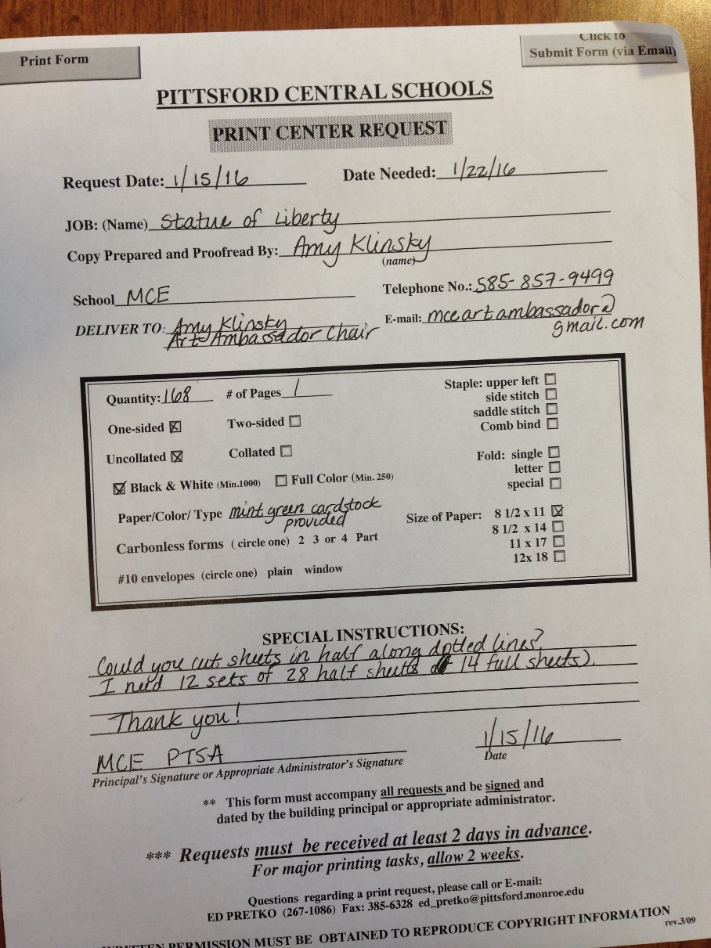
4th grade AA: Immigration/Sabuda
PREP: 1 of 5
This project needs a lot of copies:
see next screen for those details
PTSA has a fund to get copies charged to them. The form is the following link.
http://www.pittsfordschools.org/files/filesystem/PrintShop%20Request%20Form.pdf
The copying is done by Ed Pretko, District Printer, Room 306 Barker Rd. Middle School. You can get copies picked up at the Print Shop or arrange for it to be at your school. He prefers pdf files. His email is Ed_Pretko@pittsford.monroe.edu and his phone is 267-1086.
He doesn’t have specialty paper like the mint green card stock needed for this project, so you need to provide. He will cut and separate into bundles for each class amount.
The hours are: 7:30-12 and 12:30-3:30 M-F.

Slide 8
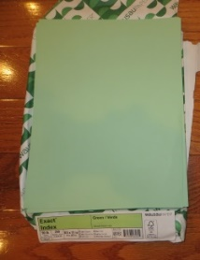

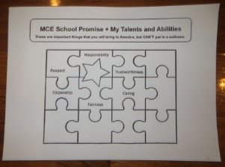
4th grade AA: Immigration/Sabuda
PREP: 2 of 5
COMPLETE Print Center Request Form (see previous page)
FOR EACH PRINT JOB
and give to Printer at Barker Middle School
“Double Headed” Statue of Liberty --- PRINT on GREEN PAPER
  Find Double Statue of Liberty “MASTER COPY” in grade’s storage bin or send PDF file TWO LADY LIBERTIES side by side + form + GREEN STOCK PAPER (preferred method).
  Complete Print Center Request Form (avail on school website)
  Copies should be made on the 90 lb. GREEN stock paper, so you have to delivery it to Printer at BRMS.
  Request on form to cut in half (along dotted line)
  Each students gets (1) Liberty…. so (1) page = 2 students
Suitcases
  Find “MASTER COPY” in the grade’s storage bin or send PDF file + form
  Complete Print Center Request Form (on school website)
  Copies should be made onto REGULAR white copy paper
  Request on form to cut into quarters.
  Each student gets (1) suit case…. so (1) page = 4 students
“My Talents & Abilities”
  Find “MASTER COPY” in the grade’s storage bin or send PDF file + form
  Complete Print Center Request Form (avail on school website)
  Copies should be made on REGULAR white copy paper
  Each students gets (1) page

Slide 9
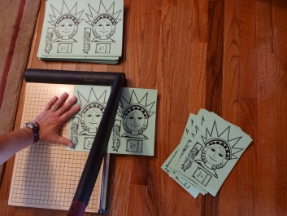
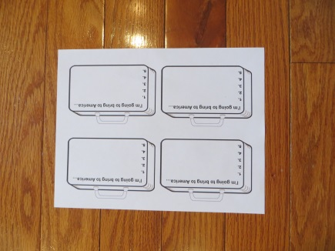
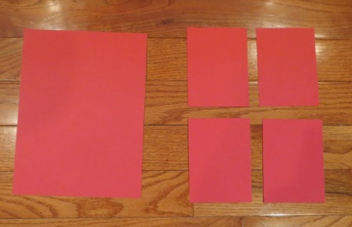
4th grade AA: Immigration/Sabuda
PREP: 3 of 5
If Printer hasn’t already done so…
CUT UP COPIES once they are returned:
DOUBLE HEADED Statue of Liberty
  Cut them down the middle carefully
  Each student gets (1)
SUITCASES:
  Cut them up leaving a little white around each one
  There are 4-suitcases per sheet
  Each student gets (1)
RED & BLUE Construction paper (9”x12” size)
  Cut each page into (4)-sections that are 4 ½” x 6” each.
  The students will glue these into their pop-up and then glue their suit case on top of it; so it’s background color to help suit case stand out as a focal point to bring in the colors of the United States.
  VIP: Each student gets only one color; RED or BLUE (alternate the two colors, so every other students gets BLUE, etc)

Slide 10
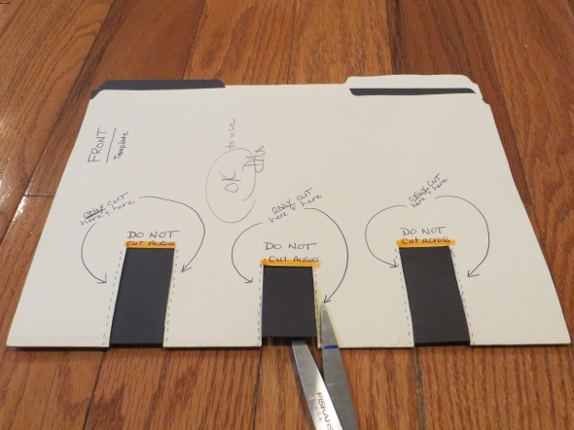
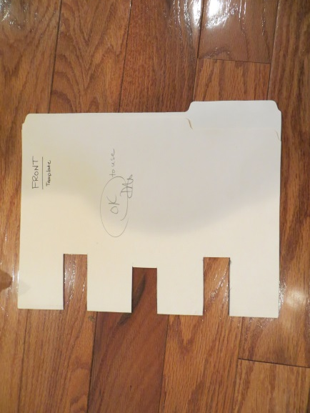
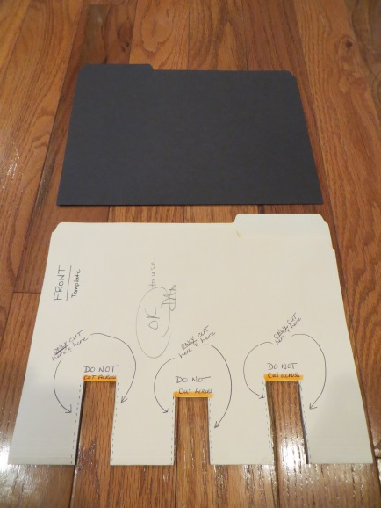
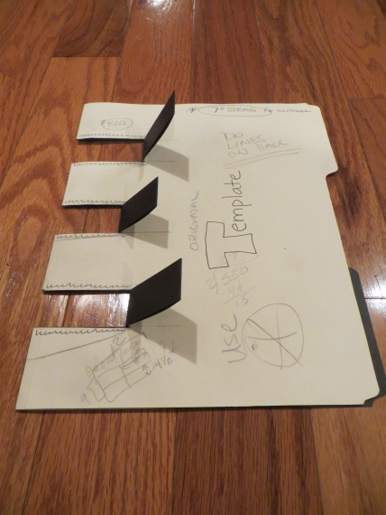
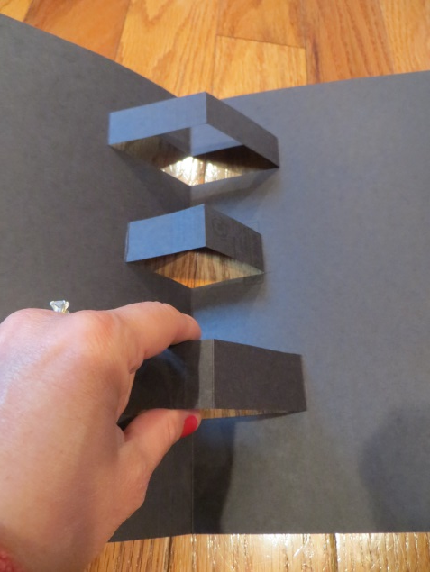
4th grade AA: Immigration/Sabuda
PREP: 4 of 5
FOLLOW THE TEMPLATE
INSTRUCTIONS: Cut ONLY the diagonal NEVER the HORIZONTAL. You are not cutting them off/out. You are just making three tabs.
Office Folder template
Place BLACK folder INSIDE office folder template
Fold tabs upward; gives you a nice crease for students to work with.
DO NOT CUT OFF tabs!
ONCE IN CLASS:
Have students carefully open their file folders and GENTLY pull these (3) tabs upwards.
Students will glue their Statue of Liberty pieces to the very FRONT of these tabs, not the top!
X=NO GLUE
X
X
X
Student’s will glue here

Slide 11
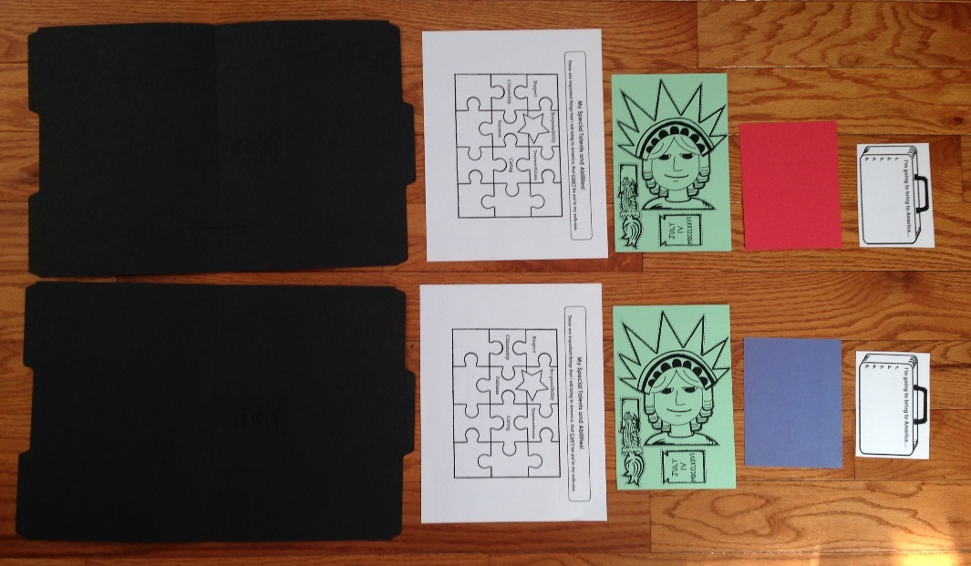
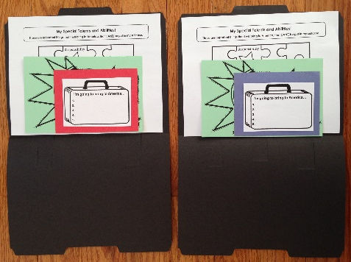
4th grade AA: Immigration/Sabuda
PREP: 5 of 5
MAKE POP-UP KITS
one per student
Get BLACK office folders (that have had tabs cut and folded up) and place one of the following inside of it:
Abilities Page
Green Card Stock Statue of Liberty
Red or Blue construction (alternate red & blue paper within the kit, so that every other student gets a blue paper, etc.)
Suitcase

Slide 12
TRAINING:
Let volunteers know problem spots (YOU TOO):
Show example of the Statue of Liberty Pop-Up project.
Ask volunteers to arrive 20-minutes early for TRAINING and to help set-up.
SHOW THEM A “PROJECT KIT” that needs to be made : Each student gets (1) KIT
  BLACK office folder: Put the following pieces inside the folder;
  (1) “Special Traits” page
  (1) Green Statue of Liberty cut-out
  (1) Piece of construction paper --- RED or BLUE (alternate colors between students in the same class)
  (1) Suitcase
FIREWORKS:
When folder is opened, the fireworks go on the LEFT side.
Once student’s complete their fire works, they will need a wipie to clean their hands.
STATUE OF LIBERTY PORTION:
Student’s need to glue their pieces, SLIGHTLY ABOVE, the tab… so the pop-up will work properly.
The TORCH goes in HER RIGHT HAND
The TABLET (Declaration of Independence) goes in HER LEFT HAND
Collect and throw away all of the paper cut out scrap.
SUITECASE:
Students will need encouragement to come up with (5) TANGIBLE items to write down to bring to America.
Gets glued on the opposite side (below) of Statue of Liberty
PUZZLE PIECES: Should be glued to the inside of the folder. TRICK: glue the folder, then stick the puzzle piece where the student wants it. Don’t let the students glue the backs of the puzzle pieces.
“SPECIAL TALENTS” PAGE; Student’s name goes into the “STAR”.
Might need help filling in the (6) puzzle pieces with traits about themselves (soccer player, piano, fencing, guitar, violin, etc)
IF TIME: Students can color their “SPECIAL TALENT’s” PAGE using colored pencils (work best).

Slide 13
4th grade AA: Immigration/Sabuda
PROJECT DUTIES:
Lead AA Person Only
1 of 3
MAKE SURE YOU BRING ROBERT SABUDA’S POP-UP Book, America the Beautiful AND sample of PROJECT
Project is done in the class rooms; 1-hour with an additional 20-minutes in the beginning for TRAINING and set-up
Arrive 30-minutes prior to the project time to set up TECH and bring materials.
STUDENTS will need their scissors AND a glue stick; hand out glue if any student needs one
Works best with 3-4 Volunteers per class
SET UP: EACH STUDENT GETS (1) BLACK OFFICE FOLDER: (the following items need to be placed inside):
      (1) GREEN Statue of Liberty pop-up
      (1) “Talents & Ability” sheet
      (1) RED or BLUE piece of construction paper
      (1) SUITCASE
  OIL PASTEL CRAYONS, (12) containers: Pass them all out, about 1 per 5 students.
  BLACK INK PEN: Each student gets (1) and remember to collect at the very end.
  (6) PLASTIC CONTAINERS: filled with puzzle pieces; 1-container per 5-6 students, placed in center of their desks.
INTRODUCTION: Immigration PowerPoint (10-15 minutes) + DURING the PP… show students Sabuda’s POP-UP book, AMERICA THE BEAUTIFUL
PROJECT: SHOW STUDENTS THE PROJECT: Statue of Liberty Pop-Up SAMPLE
STEP 1: (8 minutes)
      Students DRAW FIREWORKS
      Students create nighttime scene of fireworks w/ oil pastels.
      Suggest dotes, dashes, shooting fireworks, smudge the colors, make it look like the Grand Finale!!!
      The fireworks should be drawn on the INSIDE of the black office folder, either side.
      Once done… instruct VOL to HAND OUT WIPIES to clean their hands!
    STEP 2: (10-12 minutes)
      CUT OUT PAPER STATUE OF LIBERTY and GLUE (3) PIECES TO FIREWORKS SCENE
      Students will CUT ALONG the DOTTED LINES of their green template
      GLUE TO FRONT OF TAB ONLY.
      SLIGHTLY GLUE THE PIECES above the fold, so the pop up moves freely
      Statue of Liberty (glue to the center tab)
      Torch (glue to HER right hand)
      Declaration of Independence (glue to HER left hand)
      While students are cutting out the Statue of Liberty, collect and throw away paper clippings
      TELL/ASK THEM SOME “STATUE OF LIBERTY TRIVIA”
    STEP 3: (5 minutes)
      SUIT CASE – Tangible ITEMS that the student will bring with them to America
      Students should use BLACK INK PEN to write down (5) things they want to put in their suitcase to bring to America. These should all be TANGIBLE items (things you can touch). Might have to help them get past TECH, pets, food. Make them think!! Money – passport – medicine – photos- recipes - TOY!
      Glue suitcase to their colored piece of paper (red or blue)
      Glue this entire piece inside , centered… below Lady Liberty.

Slide 14
4th grade AA: Immigration/Sabuda
PROJECT DUTIES:
Lead AA Person Only
2 of 3
PROJECT continued:
  STEP 4: (10-minutes)
    Glue down PUZZLE PIECES
    TRICK: Tell students to GLUE FOLDER, then stick the puzzle piece down. Don’t glue puzzle pcs.
    Tell students the puzzle pieces represent all of us in the USA… our different dreams, sizes, colors, religions, ideas and how we all fit together and sometimes not always so perfectly.
    As you look at their work, take the time to point out to the other students when you see an interesting puzzle piece on someone’s art. Some are amazing and really do spark their interest in the details.
  STEP 5: (5+ minutes)
  Fill in “SPECIAL TALENTS and ABILITIES” page
    Student should place their name in the star
    Using the black pen again, fill in the remaining pieces with INTANGIBLE things. Things that make them special and/or something they are good at. These are items you can’t put in a suit case but make you special. Their love of art, basketball, math, music, horse back riding, skiing, swimming, telling jokes, etc. HELP THEM THINK!
    Tell other students what their classmates are writing to help them come up with ideas.
    Once complete, GLUE Abilities sheet to the front of their project, it covers up the holes
  STEP 6: ANY REMAINING TIME
  Tell students to get out their colored pencils (ONLY) and DECORATE their “Abilities Page”
  (markers will obliterate their writing, use colored pencils only)
CONCLUSION:
  DO/FINISH THE “STATUE OF LIBERTY TRIVIA” --- on next page
  Thank Teacher!
  Thank Volunteers!

Slide 15
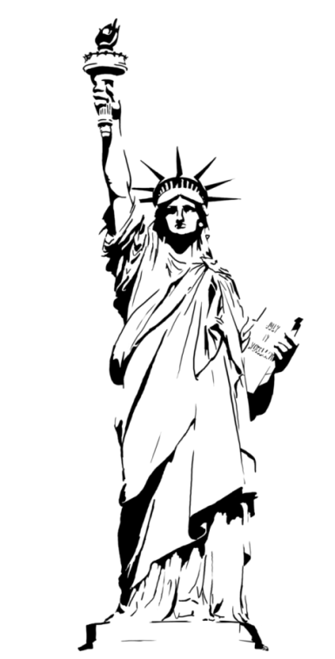
4th grade AA: Immigration
PROJECT DUTIES:
Lead AA Person Only
3 of 3
STATUE of LIBERTY TRIVIA:
Why is the base of the Statue of Liberty shaped like a star?
Built on top of Old Fort Wood. At the time she came to the U.S., we were a new country and broke!
What does the torch that “Liberty Enlightening the World” represent?
Lighting the way to peace
Which HAND does she hold the torch?
HER right hand
What is the tablet that she holds?
Declaration of Independence
Which hand does she hold the tablet?
HER left hand.
What is the date inscribed on the DOI?
July 4, 1776 in ROMAN NUMERALS
What do the (7) spikes on her crown represent?
(7) Seas: Atlantic (N & S), Pacific (N & S), Arctic, Antarctic, Indian
and the (7) continents: Antarctica, Europe, Asia, Australia, Africa, N. America, and South America.
Why is she GREEN?
Her copper cladding has oxidized (patina) she was originally BROWN. Took 30-years to turn the famous green.
    ADDITIONAL FACTS:
    305’ 1” tall (ground to the tip of the flames), 22-story building
    Spikes on her crown are 9’ long and weigh 150 lbs. each
    Roman Goddess of Liberty
    She faces SE in the NY Harbor so she greets incoming ships

Slide 16
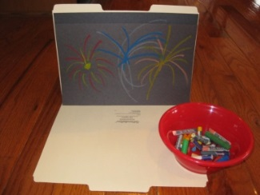
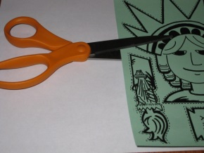

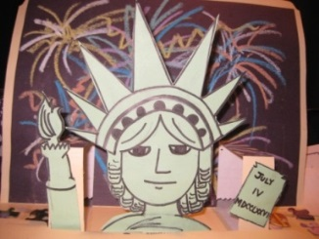
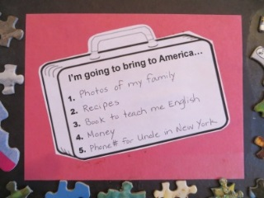
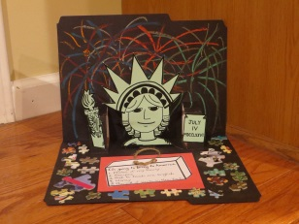
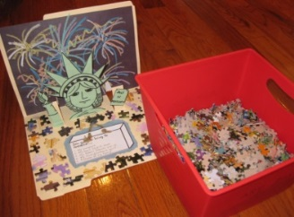
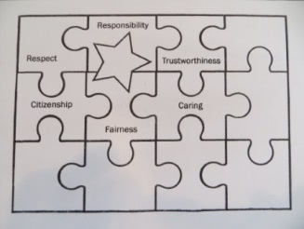

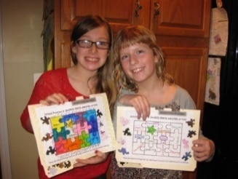
4th grade AA: Immigration
“How To” project:
Lead AA and Volunteers
Step 1
Step 2
Step 3
Step 4
Step 5
Step 6

Slide 17
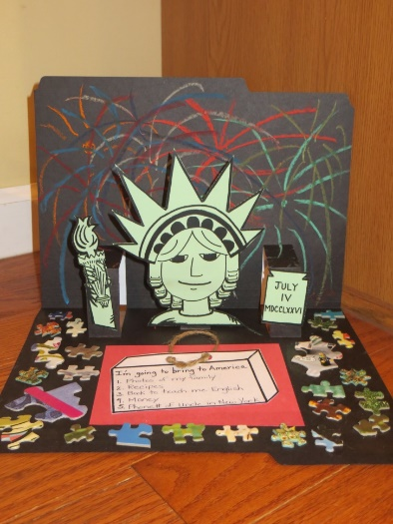
4th grade AA: Immigration
Volunteer Duties:
1 of 2
Project is done in classroom; please arrive 20-minutes early for TRAINING and to help set-up. Actual project is 1-hour.
Students will create a Pop-Up Statue of Liberty against a night time scene of fireworks.
SET UP:
  (3) Volunteers need to create the Liberty KIT: each student gets (1)
    Inside of (1) BLACK OFFICE FOLDER the following items need to be placed
        (1) GREEN Statue of Liberty pop-up
        (1) “Talents & Ability” sheet
        (1) RED or BLUE piece of construction paper
        (1) SUITCASE
  (1-2) Volunteers
    Get (6) PLASTIC CONTAINERS:
      Fill all with handfuls of puzzle pieces; at least 1-container per 5-6 students.
      Place in the center of their desks. If a lot of students (large tables) place two containers.
    OIL PASTEL CRAYONS, (12) containers: Pass them all out, about 1 per 5 students.
    BLACK INK PEN: Each student gets (1) and remember to collect at the very end.
INTRODUCTION:
  Students will see an Immigration PowerPoint and learn about Paper Engineer, Robert Sabuda (10-15 minutes)

Slide 18
4th grade AA: Immigration
Volunteer Duties
2 of 2
PROJECT:
    STEP 1: (8 minutes)
      Students DRAW FIREWORKS
      Suggest dotes, dashes, shooting fireworks, smudge the colors, make it look like the Grand Finale!!!
      The fireworks should be drawn on the INSIDE of the black office folder, either side.
      Once done… HAND OUT WIPIES to clean their hands!
    STEP 2: (10-12 minutes)
      CUT OUT PAPER STATUE OF LIBERTY and GLUE (3) PIECES TO FIREWORKS SCENE
      Students will CUT ALONG the DOTTED LINES of their green template
      GLUE TO FRONT OF TAB ONLY.
      SLIGHTLY GLUE THE PIECES above the fold, so the pop up moves freely
      Statue of Liberty (glue to the center tab)
      Torch (glue to HER right hand)
      Declaration of Independence (glue to HER left hand)
      While students are cutting out the Statue of Liberty, collect and throw away paper clippings
    STEP 3: (5 minutes)
      SUIT CASE – Tangible ITEMS that the student will bring with them to America
      Students should use BLACK INK PEN to write down (5) things they want to put in their suitcase to bring to America. These should all be TANGIBLE items (things you can touch). Might have to help them get past TECH, pets, food. Make them think!! Money – passport – medicine – photos- recipes - TOY!
      Glue suitcase to their colored piece of paper (red or blue)
      Glue this entire piece inside , centered… below Lady Liberty.
    STEP 4: (10-minutes)
      Glue down PUZZLE PIECES
      Tell students to GLUE FOLDER, then stick the puzzle piece down. Don’t glue puzzle pcs.
      Pieces represent all of us… our different dreams, ideas and how we all fit together in U.S., sometimes not always so perfectly.
      As you look at their work, take the time to point out to the other students when you see an interesting puzzle piece on someone’s art. Some are amazing and really do spark their interest in the details.
    STEP 5: (5+ minutes)
    Fill in “SPECIAL TALENTS and ABILITIES” page
      Student should place their name in the star
      Using the black pen again, fill in the remaining pieces with INTANGIBLE things. Things that make them special and/or something they are good at. These are items you can’t put in a suit case but make you special. Their love of art, basketball, math, music, horse back riding, skiing, swimming, telling jokes, etc. HELP THEM THINK!
      Tell other students what their classmates are writing to help them come up with ideas.
      Once complete, GLUE sheet to the front of their project, it covers up the holes

